Slide 1

Book Borrowing System
BITP1113/BAXU1113
15 Jan 2026
Presenter: Boom Squad
Notes:
Welcome to the Proposal Overview. This presentation outlines the background, methodology, and expected outcomes of our Book Borrowing System project. We aim to demonstrate the academic and practical value of transitioning from manual to digital library management.

Slide 2

Introduction
A computerized C++ application designed to systematize the management of book transactions
The Book Borrowing System is a C++ program designed to upgrade library records from manual logbooks to a digital format. To ensure accuracy, the system uses Data Validation to block invalid dates and Fine Automation to instantly calculate penalties without doing math by hand. By automatically tracking the library's 7-day borrowing limit, this project eliminates human error and makes managing transactions much faster and more reliable.
Figure 1: Books
Notes:
We begin with an introduction to the Book Borrowing System. This slide defines our solution as a C++ console application designed to replace manual logbooks. We highlight four key pillars: data validation, accurate duration tracking, automated overdue flagging, and precise fine calculation.

Slide 3
Problem Statement
To understand the purposes of this project, we must first examine the problem statement.
The current issue is the manual logbooks lack organization and librarians struggle with illegible handwriting.
Specific Challenges:
Lack of Data Validation
Manual recording systems often fail to detect invalid.
Complex Data Calculations
Manually calculating the date prone to human error.
Manual Status Tracking
Identifying whether a book is On Time or Overdue requires the librarian to manually
compare.
Inefficient FIne Assessment
Repetitive math slows down checkout and risks billing mistakes.
Notes:
Our project is motivated by the need to modernize library operations. Manual systems are often disorganized and error-prone, especially with date calculations. We aim to solve this by creating a reliable C++ system that automates these processes for librarians and borrowers.

Slide 4
Project Objectives
Following the problem statement, we define the goals that guide the solution.
Our goal is to organize input data efficiently and automate overdue fine calculations.
Our objectives are:
to design a robust input mechanism
to validates user data for logical consistency.
to implement an algorithm
to accurately calculate borrowing duration between any two dates.
to automate status tracking
by comparing duration against the 7-day limit.
to compute penalties automatically
for an organized final bill.
Notes:
Our objectives directly target the issues found in manual systems. By validating inputs, we prevent impossible dates; our duration algorithms ensure correct calculations; automated tracking guarantees consistent policy enforcement; and automatic fine computation ensures fast, error-free billing.

Slide 5
System Design (IPO)
Following objectives, we outline the system’s Input–Process–Output design
Input
Customer Name and Number of Books
Book Title, Borrow Date, and Return Date
Process
Validation: Check for valid dates and integers
Logic: Calculate Duration (Return − Borrow) and Overdue Days (Duration − 7)
Calculation: Multiply Overdue Days by Fine Rate
Output
Borrowing Summary with Status ([ON TIME] or [OVERDUE])
Final "Total Fine to Pay"
Notes:
This slide illustrates the System Design using the Input-Process-Output model. In the Input phase, we collect essential data such as Customer Name and Borrowing Dates. The Process phase is where the core logic resides: we validate inputs for accuracy, calculate durations accounting for leap years, and determine overdue status based on the 7-day rule. Finally, the Output phase provides a clear summary and precise fine calculation, ensuring transparent billing for the user.

Slide 6
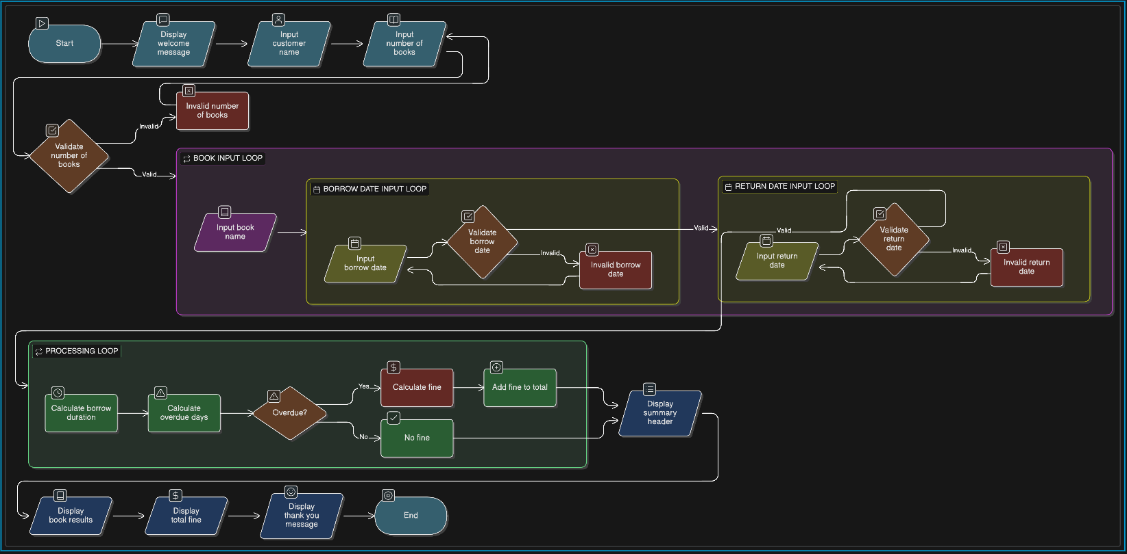
Flowchart
This flowchart shows the stages for the Book Borrowing System.
Program Flowchart: Input validation → Borrow/Return loops → Processing → Summary & totals
Notes:
Briefly walk through the flow from Start → Input/Validation → Borrow & Return loops → Overdue check → Fine calculation → Summary & totals.

Slide 7
SOURCE CODE REVIEW & DEMO
Notes:
Introduce the upcoming review of the C++ source code: structure, validation functions, date calculations, and fine logic.

Slide 8
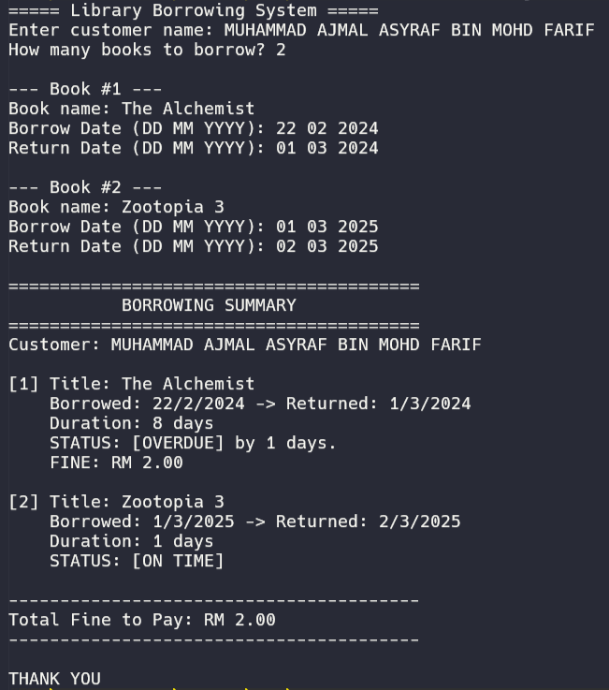
Conclusion
In conclusion, the Book Borrowing System has successfully achieved its primary objective of systematizing library transactions by transitioning from manual recording to a robust C++ application. Through the implementation of input validation and modular date algorithms, the system effectively resolves issues of human error, evidenced by its ability to handle complex scenarios like Leap Year calculations. Ultimately, the automation of overdue status tracking ensures that library policies are enforced fairly and efficiently, saving time for staff while providing a transparent and organized experience for customers.
Figure 2: Book Borrowing System
Notes:
In conclusion, the project successfully systematized library transactions, proving that digital solutions can effectively eliminate human error and enforce policies fairly. This lays the groundwork for future enhancements like database integration.

Slide 9

Thank You for Your Attention
We are now open for questions and feedback.
Notes:
Thank you for your time. This concludes our proposal presentation. I am happy to address any questions regarding the methodology or expected outcomes.

